Slide 1

C++ & DSA PLACEMENT COURSE
Khaiser Khanam

Slide 2

PROBLEM SOLVING| FLOWCHART BASICS | PSUEDOCODE, & PROBLEMS

Slide 4
Problem Solving ki basic Steps
Samasya ko samajhna (Understand the problem)
Plan banana (Plan the solution)
Solution ko implement karna (Implement the solution)
Solution ko test karna (Test the solution)
Solution ko improve karna (Improve the solution)

Slide 5



Plan Banana
Rough Solution Create Karenge
Flowchart
Pseudocode

Slide 6
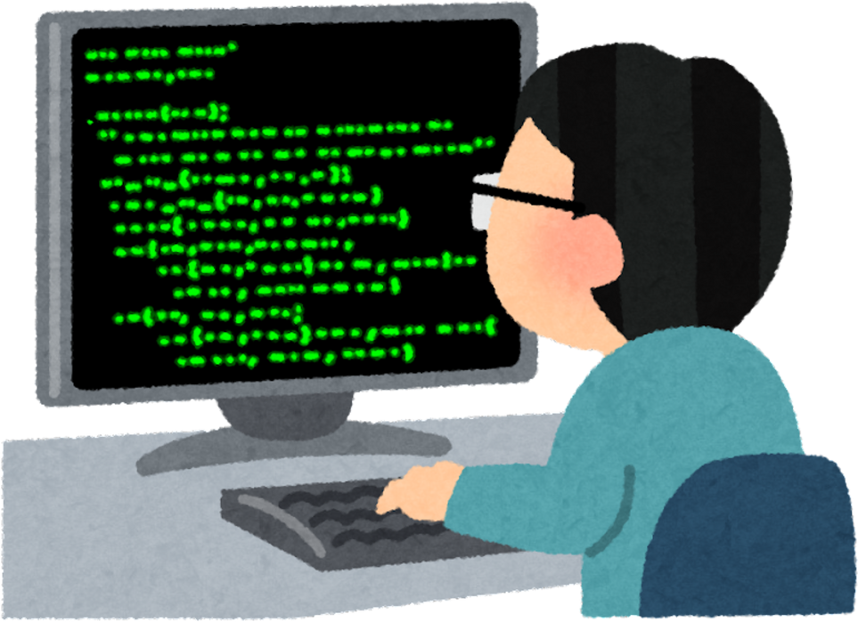


Solution ko implement karna
Flowchart
Psuedocode

Slide 7
Homework
Write the pseudocode and draw a flowchart to find the greater of two numbers.

Slide 8
Homework
2. Modify the “Sum of N Natural Numbers” pseudocode to calculate the sum of only even numbers up to N.

Slide 9
Homework
3. Write a pseudocode to count how many odd and even numbers are there from 1 to N.

Slide 10
Homework
4.Create a flowchart and pseudocode to take marks of 3 subjects and print:
Total Marks
Average Marks
Grade (A/B/C/Fail based on average)

Slide 11
Homework
5. Write a pseudocode to check whether a number is a multiple of both 3 and 5

